Slide 1
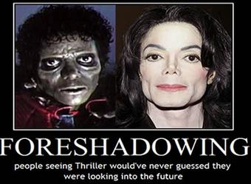
by: daziona, Monica, deon, and flor foreshadow :
An author use of clues two prepare readers for events that will happen later.
Ex: People seeing thriller would’ve never guessed they were looking into the future.

Slide 2
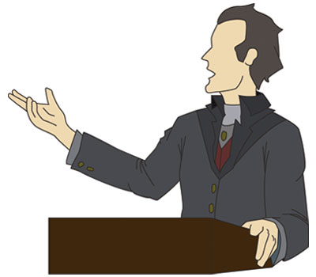
Monologue:
A long speech of written expression of thoughts by a character in a literacy work.

Slide 3
Irony:
A contrast or discrepancy between appearance and reality.

Slide 4
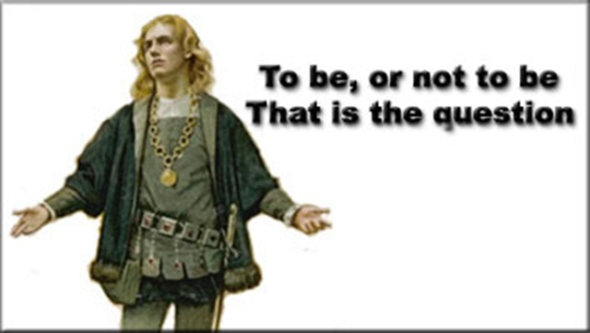
Soliloquy:
A dramatic device in which a character alone on stage.

Slide 5
Metaphor:
A figure of speech that makes a comparison between two seemingly unlike things.

Slide 6
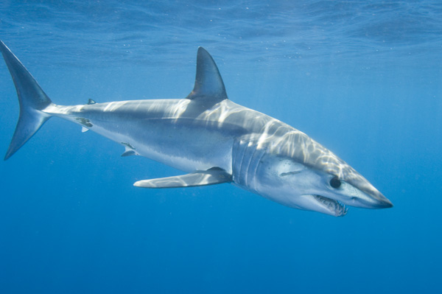
Simile:
A figure of speech involving the comparison of one thing with another thing of a different kind
Ex: Sharks; Eyes like diamonds cold as ice teeth like razors search for victim

Slide 7
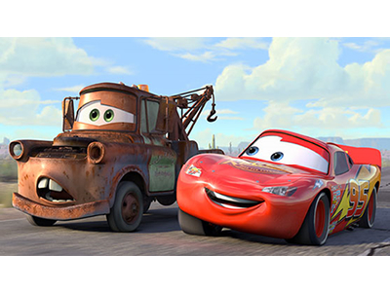
Personification:
A figure of speech in which an animal or an object that has human characteristics.
Ex: The cartoon from Disney Channel “Cars”

Slide 8
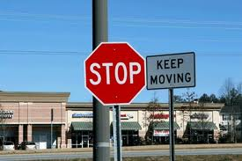
Oxymoron:
A figure of speech in which opposites are combined.
Ex: The stop sign and the keep moving sign they are opposites that are together.

